Slide 1
Dwelling on Dwellings
John Eisler
Community Development Director
October 29, 2025 Work Session

Slide 2
The issue:
Accessory structures with habitable space have been able to get land use/building approval and thereafter are converted to living quarters.
Creates fire, life, safety concerns and cheats residential density standards.
Leads to code compliance cases and/or future property purchasers being misled.
Ambiguity/confusion for staff.

Slide 3
Current Code
“Accessory dwelling unit” means an interior, attached, or detached residential structure that is used in conjunction with or that is accessory to a single-family dwelling.
“Accessory use” or “accessory structure” means a use or structure incidental and subordinate to the main use of the primary structure or the primary use of the property and which is located on the same parcel as the primary use.
“Dwelling unit” means one or more rooms in a building designed for occupancy by one family and having not more than one cooking facility.

Slide 4
Current Residential Specialty Code
“Dwelling” means any building that contains one or two dwelling units used, intended, or designed to be built, used, rented, leased, let hired out to be occupied, or that are occupied for living purposes.
“Dwelling Unit” means a single unit providing complete independent living facilities for one or more persons, including permanent provisions for living, sleeping, eating, cooking and sanitations.
“Kitchen” means an area used, or designated to be used for the preparation of food.

Slide 5
Where are the lines?
Dwelling = not more than one cooking facility?
Kitchen = area used for the preparation of food? What does that mean?
Accessory structure = incidental and subordinate to main use…
  But it’s a shop!

Slide 6
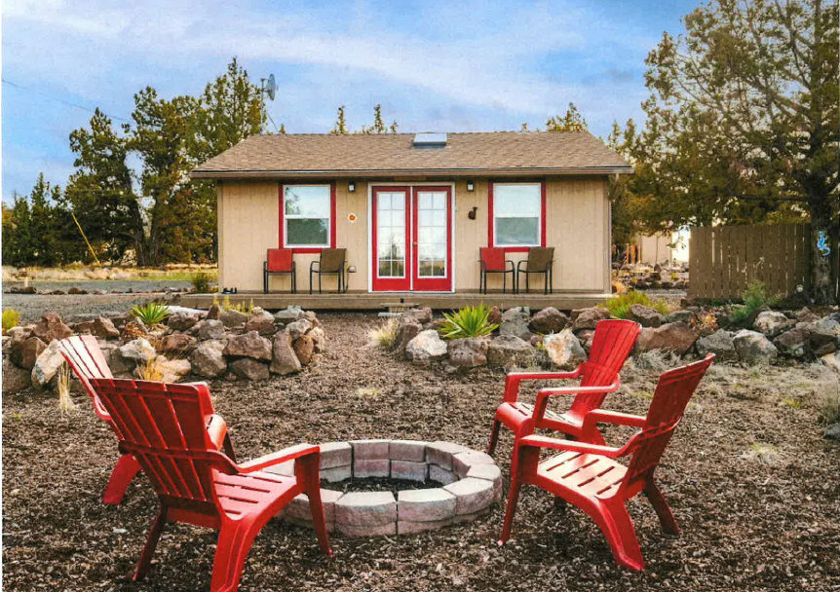
“Shop” with full bath

Slide 7
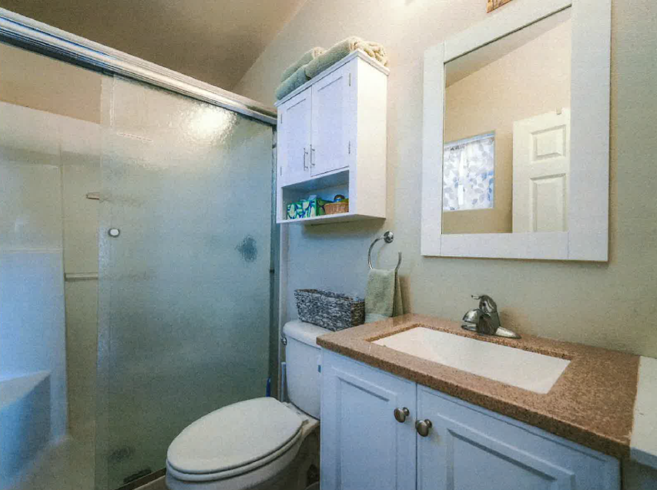
“Shop” with full bath

Slide 8
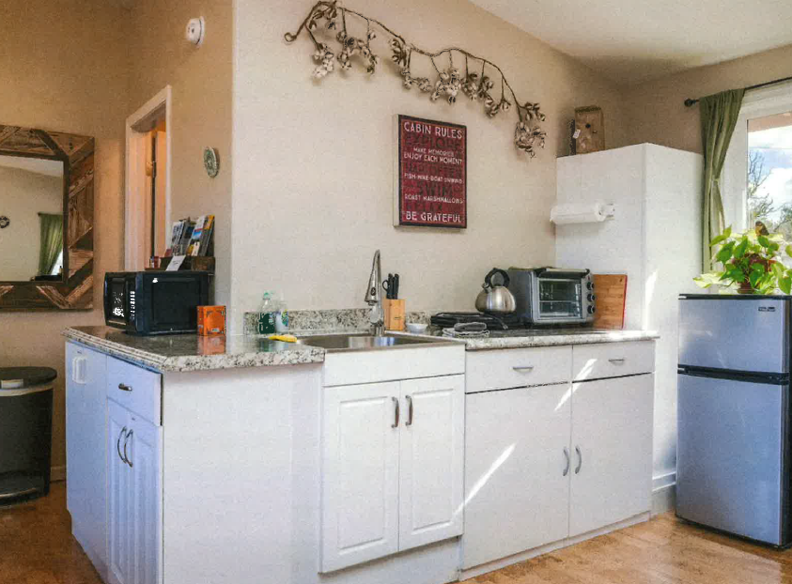
“Shop” with full bath

Slide 9
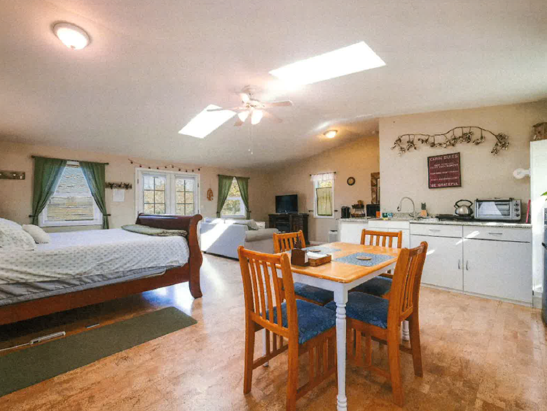
“Shop” with full bath

Slide 10
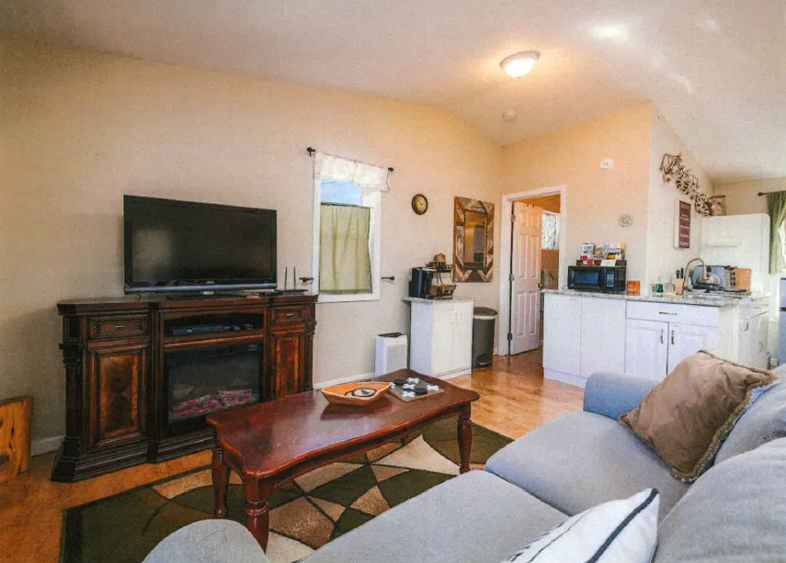
“Shop” with full bath

Slide 11
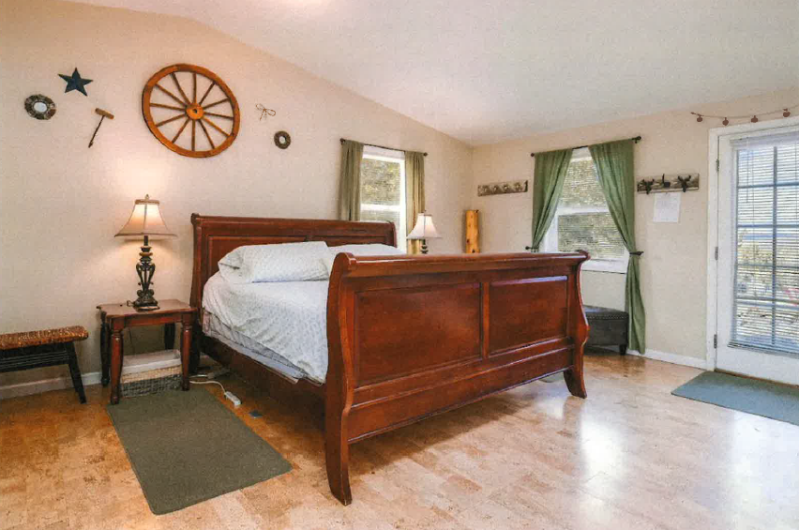
“Shop” with full bath

Slide 12
Proposed fix
18.08.040 D Definitions
“Designed for occupancy” means a structure or portion of a structure with greater than three interior plumbing fixtures, designed to include permanent independent living facilities, including but not limited to a kitchen, bath, and space for a bedroom.
18.08.110 K Definitions –
“Kitchen” means an area within a habitable space designed to be used for the preparation of food, which includes a 240-volt electrical outlet or gas piping and at least two of the following: a sink, countertop exceeding 6 lineal feet, dedicated space and electrical outlet capable of supporting a refrigerator exceeding 5.0 cubic feet, or space with access to electrical and drain hookups that could reasonably be used for a dishwasher.

Slide 13
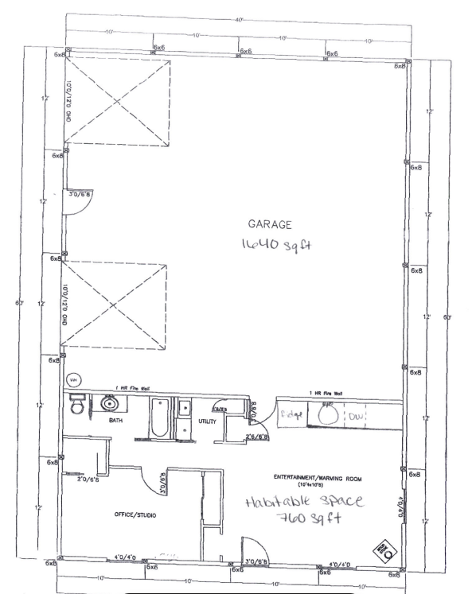
Example of common permitted structure

Slide 14
Example of common permitted structure
Will not be permitted in the future:
6 plumbing fixtures (toilet, bath, bath sink, washer, kitchen sink, dishwasher)
Kitchen + full bath + space for bedroom
“designed to include permanent independent living facilities”

Slide 15
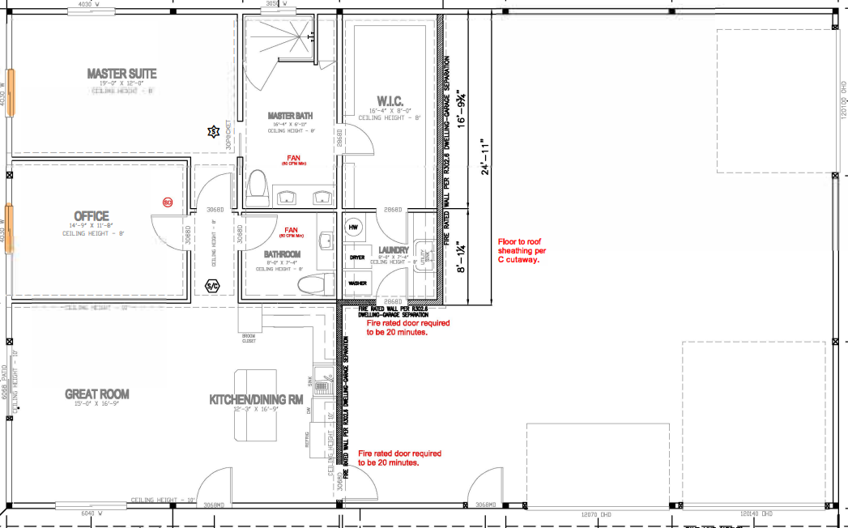
Example of common permitted structure
(Powell Butte)

Slide 16
Example of common permitted structure
(Powell Butte)
Will not be permitted in the future!
9 plumbing features (master bath shower + toilet + 2 sinks; bath toilet sink; laundry sink + washer; kitchen sink + dishwasher)
Kitchen + full bath + space for bedroom
“designed to include permanent independent living facilities

Slide 17
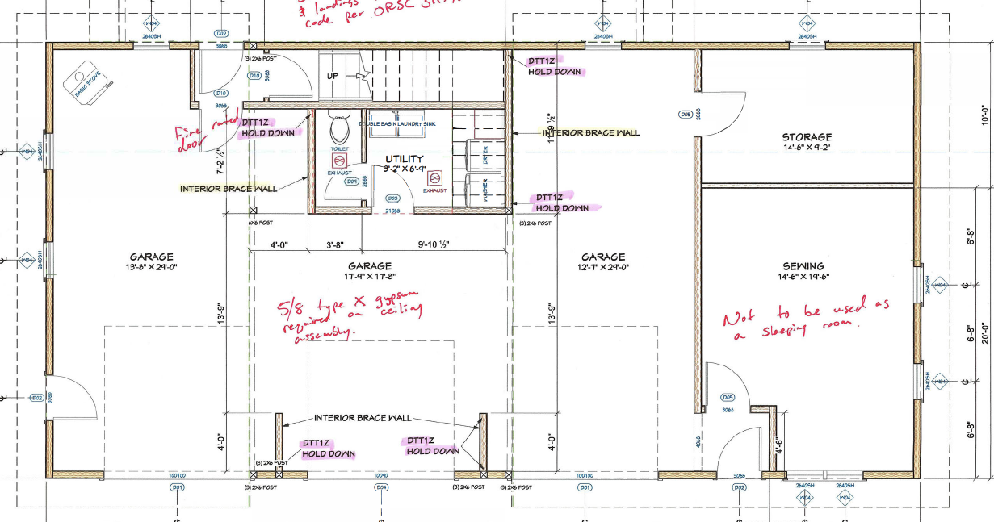
Example of common permitted structure
(Outer Prineville)

Slide 18
Example of common permitted structure
(Outer Prineville)
Will be permitted!!
3 plumbing fixtures (toilet + sink + washer)
Stove but no other kitchen plumbing, countertop
Is dependent on main dwelling for bathing + food prep/sanitation, regardless of what happens with “sewing” room

Slide 19
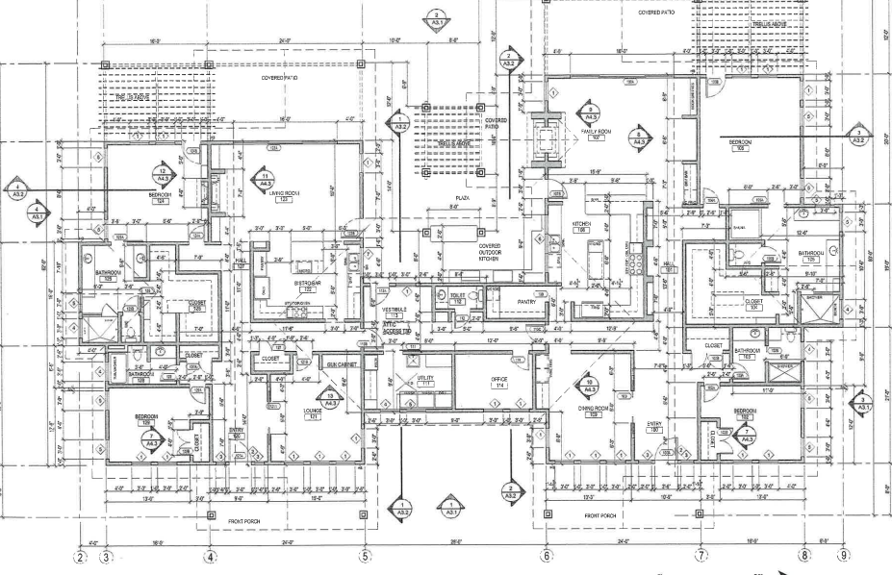
Dwelling Unit or Units??

Slide 20
Dwelling Unit or Units??
“Dwelling, two-family”
means a building containing two dwelling units and designed for occupancy by two families.
= 2 complete dwelling units/independent living facilities under new definition

Slide 21
Questions or brilliant ideas?
Next steps – make any necessary adjustments to language
Include with big code update in December

