Slide 1
Upper Trout and Bridge Creeks Vegetation Management Project (UTB)
Lookout Mountain Ranger District, Ochoco National Forest
Jon Kochersberger, Interdisciplinary Team Leader

Slide 2
Purpose & Need
Restore historic vegetative conditions
Increase resilience and durability to insects, disease, fire and drought
Reduce catastrophic wildfire risk
Improve firefighter ingress and egress

Slide 3
Policy & Forest Direction
EO 14225 Immediate Expansion of American Timber Production
Secretarial Memo 1078-006 Emergency Action Determination
Reduce threats to public health & safety through improving durability, resilience, and resistance to fire, insects, and disease within National Forests and Grasslands
Aligns timber production with public and fire fighter safety
Environmental Analysis (EA) (Final deadline ~Feb 2027)
Final proposed action NLT March 1, 2026
Sale out for bids ~Oct 2027
Notes:
Project objective: increase timber production while improving forest health and reducing hazardous fuels that could impact adjacent property owners

Slide 4
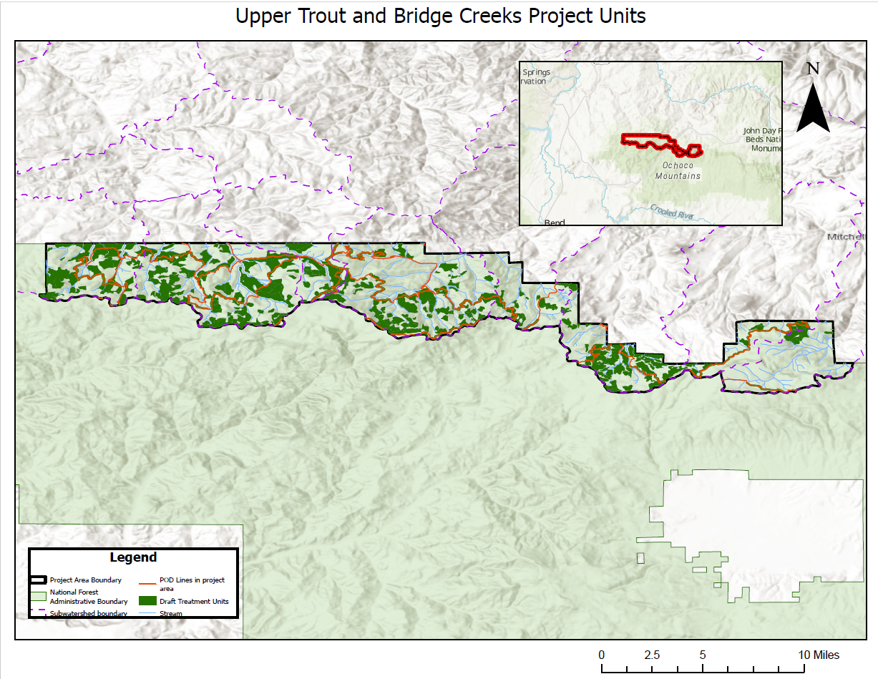
Project Area
~55,000 acres
Treated area will likely be 13,000-15,000 acres
Includes Foley Cr, Headwaters Trout Cr, Opal Cr, Upper Bear Cr, Middle Bear Cr, West Branch Bridge Cr, Upper Bridge Cr, and Headwaters Bridge Cr sub-watersheds
Bounded by private lands and southern subwatershed boundaries

Slide 5
Proposed Treatments
Commercial timber harvest
Non-commercial thinning
Prescribed burning of activity fuels
Treatments will occur in Category 4 Riparian Habitat Conservation Areas (RHCAs) with resource protection measures
Some thinning to occur along Potential Operational Delineations (POD) to create shaded fuel breaks to increase safety and effectiveness of wildfire response

Slide 6
Environmental Considerations
Minimal treatments in Riparian Habitat Conservation Area (RHCAs)
Protection of critical mid-Columbia River steelhead habitat
Address widespread insect and disease impacts

Slide 7
Additional Considerations
No road closures will be proposed as part of this project
No stream restoration or aspen treatments will be proposed as part of this project
2019 Bear Cluster Allotment Management Plan EIS approved stream restoration activities along ~17 miles of streams in the Bear Cr and Bridge Cr sub-watersheds and 13 Aspen stand treatments
12.5 miles of stream restoration was completed in the Trout Cr sub-watersheds from 2019-2023

Slide 8
Implementation Approach
One action alternative analyzed
Streamlined environmental analysis
Emphasis on transparency
EA/FONSI signed within one year once the proposed action has been formalized

Slide 9
Expected Outcomes
Improved forest health and resilience
Reduced risk to communities and firefighters by addressing hazardous fuels
Increased timber production
Meaningful outcomes delivered efficiently

