Slide 1
Landlord Tenant Law in Oregon Part 2
Legal Aid Services of Oregon
42 NW Greeley Ave, Bend, OR 97703
541-385-6944

Slide 2
Disclaimer
This presentation is meant as general legal information
This presentation is not legal advice
I am not your lawyer
If you have a specific legal question, Legal Aid Services of Oregon provides free legal services to low income people or you can contact a private attorney

Slide 3
The law is complicated!
Websites created by non-profits
Legal Aid: www.oregonlawhelp.org and www.oregonrentersrights.org
Community Alliance of Tenants: www.oregoncat.org
Fair Housing Council of Oregon: www.fhco.org
Disability Rights Oregon: www.droregon.org
Oregon State Bar: https://www.osbar.org/public/
Or talk to a lawyer:
Legal Aid for Deschutes/Crook/Jefferson: 541-385-6944
Oregon Lawyer Referral Service: 1-800-452-7636

Slide 4
When does Landlord Tenant Law apply?
Landlord Tenant Law does apply when there is a rental agreement (written or oral)
Landlord Tenant Law does not apply:
Motels, for stays less than 30 days
Dorms or nursing homes
Housing as part of employment
Couch surfers or guests

Slide 5
What are we covering in Part 2?
COVID-19 Changes
Rights and Responsibilities During a Tenancy [Rent, Repairs & Rules]
Moving Out [Termination Notices & Court Eviction Process]

Slide 6
COVID-19 Changes

Slide 7
House Bill 4401
Statewide eviction moratorium that took effect 1/1/21
To qualify for most protections, tenant must fill out and sign a sworn declaration of financial hardship to be protected
These protections expire 6/30/21
If tenant cannot sign declaration, rent from April-December 2020 must be paid by 3/31/21
Some no cause terminations are not allowed right now – but landlord-based 90 day notices are permitted
For cause terminations (other than non-payment) and rent increase laws are not changed by HB 4401
Non-payment of rent notices – landlord must give a 10 day notice (instead of 72 hours) through June 2021

Slide 8
Rent, Rent Increase, Landlord Access, Repairs
Rights and Responsibilities
During a Tenancy

Slide 9
Rental Agreement
All parties should keep a copy of it.
Everyone should review and understand this legally binding document: Ask questions, get clarifications in writing.
Understand the full costs:
What utilities are included? Are there fees?
Landlord required to give tenant a copy when the document is signed
Landlord can charge if tenant needs a copy later
Oral agreement counts
A rental agreement cannot reduce the rights of the tenant granted by the Oregon Residential Landlord Tenant Act

Slide 10
Paying the rent
Landlord can specify where and how (cash/check/money order)
Most rent is due on the 1st
Late fee after five days late
Landlord should give a receipt

Slide 11
Rent Increases ORS 90.323
Rent cannot increase during a fixed term lease
Rent can increase when a new lease is signed
In month-to-month tenancy, rent cannot increase during the first year
After the first year, landlord must give 90 days written notice of the increase and cannot increase the rent by more than 7% + CPI per year (in 2021 it is set at 9.2%). UNLESS . . .
First certificate of occupancy was issued less than 15 years ago or the unit is assisted housing

Slide 12
Right of entry
Landlord must give 24 hours’ actual notice before entering the rented unit
Actual notice can be a phone call, text message, email, etc.
Except:
Serving notices
Emergency
Maintenance requests (within 7 days)

Slide 13
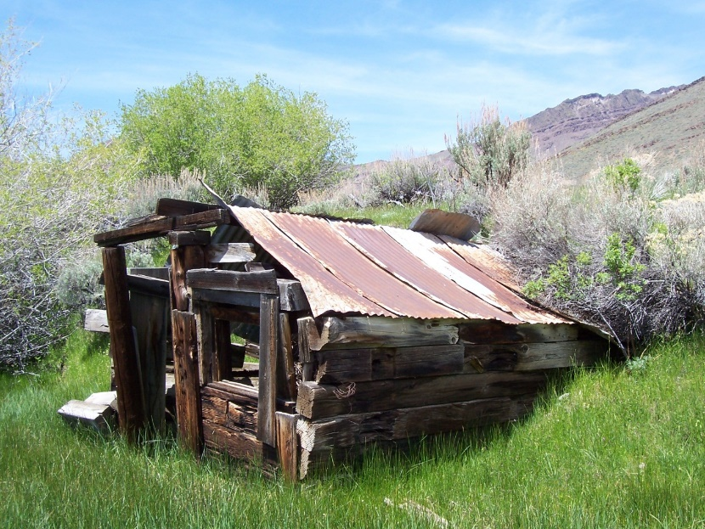
Landlord must provide a habitable premise
Effective weather protection (roof, doors, exterior walls)
Plumbing
Hot & cold running water
Heat
Electric wiring and lights
Working keys, locks, window latches

Slide 14
Landlord must provide, cont.
Smoke detectors (and carbon monoxide detectors if a source of CO exists)
Common areas free from garbage, rodents, vermin & safe for normal and expected use
If provided, landlord must maintain:
Appliances, air conditioning, elevators
Garbage containers and service

Slide 15
Tenant must…
Use house as intended
Keep the unit clean
No vermin, garbage, rodents
Keep all plumbing as clean as possible
Test and replace smoke detector batteries every six months
Do not disturb other tenants
Abide by lease (maintain landscaping if required, etc.)

Slide 16
Repairs (maintenance requests)
Tenant should (but is not required to) make requests in writing and keep a copy
Landlord can’t retaliate for repair requests

Slide 17
If landlord doesn’t fix it…
If repair will be less than $300,
Tenant can notify landlord in writing that tenant will fix it if repair is not made by a certain date
Hire someone to do the work
Give landlord copy of invoice
Deduct cost from next month’s rent
OR…
Give notice that if landlord doesn’t fix it within 14 days, tenant will move in 30 days
Must move if repair not made

Slide 18
For failure of essential service
Tenant can:
Deduct the cost of replacement services from rent (such as eating at a restaurant or buying bottled water)
Get compensation for the damage caused
Obtain substitute housing and seek reimbursement from the landlord
Terminate the tenancy with 48 hours’ notice (move)
Essential Service = heat, plumbing, running water, gas, electricity, light fixtures, locks for exterior doors, latches for windows an any cooking appliance or refrigerator supplied by landlord. ORS 90.100(13)(a)(A)

Slide 19
If repairs are not made…
Tenant should talk to an attorney about options before withholding any rent
Before withholding any rent, the tenant needs to document their complaints and plan to withhold rent in writing (and keep a copy)

Slide 20
Neighbor problems
Usually not the landlord’s problem!
Unless neighbor is also a tenant and there is a safety risk or harassment based on a protected class
If there is a safety risk, discrimination or harassment, tenant should notify the landlord in writing and keep a copy of complaint
Community Solutions of Central Oregon
541-383-0187

Slide 21
Other problems…
New room mates
Landlord must approve
Must pay application fee & pass background check
Guests
Rules on how long a guest can stay should be in the rental agreement
Common rules
Making noise at night; Disturbing other tenants; Smoking; Parking – should be in the rental agreement
Pets
Landlord can: prohibit pets, require additional pet deposit, restrict by weight/breed/type
BUT ---- an animal needed to help with a disability is not a pet!

Slide 22
Help after domestic violence
Changing locks
Remove abuser from lease
Break lease or move with 14 days’ notice
Saving Grace: 541-389-7021
Legal Aid: 541-385-6944

Slide 23
Tenant Choice, Termination Notices, Court Eviction
Moving Out

Slide 24
Moving out… tenant choice
Tenant must give landlord at least 30 days’ notice in writing to terminate a month-to-month tenancy
Tenant must move at end of 30 days
Tenant must pay rent until the date the tenancy terminates
Tenant should clean and take pictures of the unit at move-out
Tenant should give landlord forwarding address and forward mail through USPS

Slide 25
Breaking a lease
If tenant moves out fix ‘without cause’ during the fixed term tenancy, the landlord can charge actual damages (cost of renting to new tenant)
Or, if your lease allows, they can charge a lease break fee of 1.5 times the monthly rent

Slide 26
Landlord wants the tenant to leave…
For Cause – Any rental agreement
30 day for cause notice (14 days to fix)
10 day notice (for repeat violation)
24 hour for cause notice (serious crimes, threats)
72 hour notice (for nonpayment of rent)
Requirements:
Move out date & time (must be clear, specific and give enough time)
Sufficiently state cause
Give information about how to cure
Delivery requirements

Slide 27
No Cause Termination
30 day no cause notice – only during first year of month-to-month tenancy
If Landlord lives with the tenant, can give a 60 day no cause notice after the first year

Slide 28
Landlord Cause: After First Year of Tenancy
Landlord can give 90 day notice if:
Landlord intends to demolish or use for other than residential purposes
Landlord intends to repair and will be unsafe
Landlord will use as primary residence for a family member
Landlord has sold and new owner plans to move in
Landlord has to pay the tenant one month’s rent unless Landlord has four or fewer units!

Slide 29
Fixed Term
If Landlord doesn’t give notice before the term expires, most fixed term tenancies roll over into month to month
Landlord can refuse to renew a fixed term tenancy in the first year (but must give written notice 30 days before the tenancy terminates)
After the first year, Landlord cannot refuse to renew except . . .
If the tenant committed three or more violations of the rental agreement within the preceding 12 months and landlord gave three written warnings at the time of the violations, landlord can refuse to renew fixed term tenancy
If the landlord terminates based on this three strikes rule – they must give 90 days notice (notice must specify reason for termination and supporting facts)

Slide 30
Termination of Tenancy Notice ≠ Eviction
Landlord cannot change locks or have sheriff remove the tenant before going to court!

Slide 31
Court Eviction Process
1. Landlord serves a notice of termination
2. Tenant doesn’t leave by the deadline.
3. Landlord files an eviction (FED) case in court
4. Tenant is served a summons and complaint
5. Tenant must attend “first appearance”
At first appearance, parties have the chance to mediate an agreement, or
Tenant must file an answer
6. Eviction trial – determines who gets possession of the rental
Tenant wins and gets to stay, or
Landlord wins and tenant must move

Slide 32
Documentation, Legal Advice and Court
Retaliation is against the law . . . but it can be hard to prove
Tenant should document any complaints to landlord or verbal agreements
Landlord Tenant Act is very technical ---- both tenants and landlords frequently make mistakes – get legal advice
Legal advice might be free ---- prevailing parties in landlord tenant cases often receive attorney fees
Oregon State Bar Lawyer Referral Service: 1-800-452-7636
Legal Aid Services of Oregon: 541-385-6944
Court decisions and court mediated agreements are final --- get legal advice before going to court

Slide 33
Legal Aid Services of Oregon
Questions?
42 NW Greeley Ave, Bend, OR 97703
Intake line: 541-385-6944

