Slide 1
DIVORCE & CUSTODY IN OREGON
A presentation by legal aid services of OREGON

Slide 2
About legal aid services of oregon
Statewide provider of free civil legal services.
The Central Oregon office serves Deschutes, Jefferson, and Crook Counties.
4 full-time attorneys, 2 bi-lingual support staff.
Income restrictions on who we can serve.
Only take certain types of cases: we primarily help low-income tenants, survivors of domestic violence, workers facing discrimination in employment, and people needing help with public benefits.

Slide 3
About legal aid services of oregon
Statewide provider of free civil legal services.
The Central Oregon office serves Deschutes, Jefferson, and Crook Counties.
4 full-time attorneys, 2 bi-lingual support staff.
Income restrictions on who we can serve.
Only take certain types of cases: we primarily help low-income tenants, survivors of domestic violence, workers facing discrimination in employment, and people needing help with public benefits.

Slide 4
Disclaimer
This presentation is intended to provide legal information, not legal advice about your specific case.
Please do not share information about your specific case during this presentation.
I am not your lawyer. My office only represents low-income Oregonians in very specific types of cases. To become a client, you must complete an intake and go through our application process.
The law is constantly changing and evolving. The information in this presentation is accurate today, the law could easily change next month or next year. If you have questions, always talk to an attorney.
Feel free to ask general questions about divorce and custody during the presentation.

Slide 5
OUTLINE
The role of lawyers in divorce and custody cases
Finding reliable legal information
Overview of divorce & custody case process
Mandatory steps that must be completed before trial
Optional steps to complete before trial
Court hearings in your divorce or custody case
Divorce and custody trials

Slide 6
THE ROLE OF LAWYERS

Slide 7
Do you need a lawyer?
It depends. Not everyone needs a lawyer to get a divorce or establish custody. You should talk to an attorney if any of the following apply to your case:
You or the other party have lived in multiple states in the last six months.
You don’t know where the other party is / they’ve disappeared.
A third party is seeking custody of or visitation with your children.
For divorce cases only: You have retirement accounts, real estate, a business, or a significant amount of debt that you need the court to divide.

Slide 8
Options for hiring a lawyer
There are various ways you can use an attorney depending on the amount of money you can afford to spend:
Case consultation (cheapest)
Limited scope services (mid-range option)
Full representation (most expensive)

Slide 9
How to find a lawyer
Ask a friend, family member, or co-worker who has been through a divorce or custody case if they know any good family law attorneys
Oregon State Bar Lawyer Referral Service:
https://www.osbar.org/public/ris/
503-684-3763 or toll-free in Oregon at 800-452-7636 (8 am to 5 pm, Monday – Friday)
If possible, talk to two or more attorneys so you can find a good fit

Slide 10
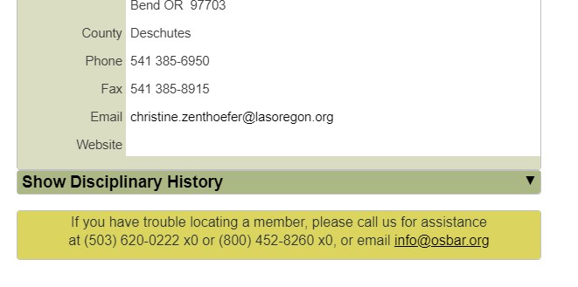
Lawyer credentials / discipline
Always look up a potential lawyer on the Oregon State Bar membership directory to verify they are licensed to practice law in Oregon and do not have a disciplinary history.
https://www.osbar.org/members

Slide 11
Working with a lawyer
Review retainer agreement carefully & ask questions
Have a frank conversation about money – let the attorney know how much money you have to spend and what they can accomplish with that amount of money
Talk to your lawyer about your expectations and whether those are realistic with your budget and / or their schedule and the way they practice law
Talk to your lawyer about communication, how quickly they respond, what type of communication expectations do they have for you
Understand your lawyer’s expectations for you

Slide 12
client CASE STUDY
Client Diana hired Attorney John to represent her in her divorce. Diana only had $5,000 to spend on her divorce. John asked for a $5,000 retainer up front, which Diana was able to pay. John helped Diana file for divorce and obtain a temporary custody order after a court hearing. John then informed Diana that he had used up her retainer and he needed $5,000 more or else he would have to withdraw. Diana did not have another $5,000 so John withdrew from her case. Diana was then left to finalize her divorce on her own.

Slide 13
What could Diana do DIFFERENTLY?
Some attorneys are willing to provide limited scope services. Diana could ask the attorney whether she can perform certain tasks on her own in order to save money. For example, she could prepare her own divorce petition and have her attorney review her paperwork. She could also obtain evidence for court hearings on her own. She could also go to some types of non-evidentiary court hearings on her own.

Slide 14
FINDING RELIABLE LEGAL Information

Slide 15
Be wary of information online!
Do not rely on divorce or custody information you find in Google searches or read in online discussion forums.
Every state has different laws governing divorce and custody. Unless you find a website with information specific to Oregon cases, it is unlikely the information will be accurate.

Slide 16
Be wary of advice from friends, family, co-workers or other non-attorneys
People love to share stories about their divorce and custody cases. Do not listen to these stories! It is very unlikely that their advice will be accurate or that what happened to them will happen to you.
The law is complicated. Unless someone is an Oregon family law attorney, they cannot give you accurate advice about what will happen in your Oregon divorce or custody case.

Slide 17
Reliable sources of legal information online
Family law lawyers – not all lawyers understand family law. If you get advice from an attorney, make sure that they are experienced in divorce and custody cases.
Oregon State Bar website (https://www.osbar.org/public/legalinfo/family.html) – free legal information about divorce and custody cases written by Oregon attorneys
Oregon Judicial Department website (https://www.courts.oregon.gov/programs/family/ Pages/default.aspx) – free legal information, court forms, parenting plans, self-help videos, and more created by Oregon attorneys and judges.
OregonLawHelp.org (https://oregonlawhelp.org/issues/family) – free legal information written by Oregon Legal Aid attorneys.

Slide 18
Free legal booklets
Divorce and Custody Trials in Oregon booklet – a comprehensive guide to prepare for a divorce or custody trial in Oregon. This booklet was written by Oregon attorneys and judges. This booklet is available online. You may also be able to obtain copies at your local courthouse. https://www.courts.oregon.gov/programs/family/selfhelp/Documents/Divorce%20and%20Custody%20Trials%20in%20Oregon.pdf
Family law in Oregon booklet – a comprehensive guide to family law issues in Oregon written by Oregon Legal Aid attorneys. This booklet is available online. You may also be able to obtain copies at your local courthouse. https://oregonlawhelp.org/files/CCDACC15-944D-570E-7F1F-7BBF3DEC0018/attachments/38C73A69-0687-57F4-2199-D3B9EB84395F/376212010%20Family%20Law%20in%20Oregon%20PDF%20English.pdf

Slide 19
Divorce & custody case process

Slide 20
Uncontested divorce or custody case process
STEP 1
Petitioner files divorce petition and other paperwork with court
Petitioner has the other party served
STEP 3
Petitioner completes mandatory parenting class (if children are involved)
STEP 2
STEP 4
STEP 5
If no Response is filed in 30 days, Petitioner files default paperwork with court
Petitioner waits for court to sign default judgment. Once judgment is entered in court file, case is concluded.

Slide 21
contested divorce or custody case process
STEP 1
Petitioner files divorce petition and other paperwork with court & has other party served
If other party files a Response, case becomes contested. Petitioner should review Response to understand what issues Respondent disagrees on
STEP 3
Both parties must completed the mandatory parenting class if children are involved in the case
STEP 2
STEP 4
STEP 5
Both parties should attempt to resolve issues they disagree on through mediation or negotiation
If the parties cannot reach an agreement, they will have to have a trial. After trial, the judge’s decision will be incorporated into a final judgment

Slide 22
STARTING A DIVORCE OR CUSTODY CASE
A divorce or custody case starts with a “Petition.” This document gives the Respondent and the court notice of the Petitioner’s position on the issues in the case.
If Petitioner has an attorney, attorney can prepare the Petition and other initial paperwork.
If Petitioner does not have an attorney, court forms for starting a case are available online on the Oregon Judicial Department website or at your local courthouse.
Waiver of filing fee. If Petitioner is low-income, they can request a waiver of the $300 filing fee.
Generally, it doesn’t matter who files first!

Slide 23
GETTING HELP COMPLETING YOUR PAPERWORK
Attorneys
If you’ve hired an attorney, they will draft your divorce or custody paperwork for you and file it. All you need to do is review the paperwork and sign if it is correct.
If you can’t afford to hire an attorney for full representation, you may be able to hire an attorney to review your paperwork to make sure it’s been filled out correctly.
Court facilitators
Most county courts in Oregon have family law facilitators who can review your paperwork to make sure it’s been completely filled out and that you have all the correct forms.
Crook County usually has workshops to assist with divorce and custody forms. These have been suspended due to COVID-19.

Slide 24
SERVING THE OTHER PARTY
“Serving” the other party is about ensuring they have adequate notice of paperwork filed in a court case. There are heightened service requirements when a party serves someone with initial divorce or custody papers:
In-person
Substitute service
Acceptance of service
Requesting alternative forms of service
Note: After a case is started, court papers can be served on the other party by mailing the paperwork using regular, USPS mail to the address on file with the court.

Slide 25
STATUTORY RESTRAINING ORDER
In Oregon, after a divorce case is filed and served on the other party, there is an automatic restraining order that goes into effect.
This restraining order prohibits either party from:
Changing or cancelling health, homeowner’s, renter’s, or automobile insurance policies that cover either party or the minor child of either party; and
Selling, disposing of, or encumbering (taking out a loan) any property that the other party has an ownership interest in.
If a party needs to modify the order or if a party violates the order, the other party can request a court hearing.

Slide 26
RESPONSE
The Respondent has 30 days to file a “Response” to the Petition if they disagree with anything in the Petition.
A Response will indicate what issues the Respondent disagrees with the Petitioner on.
A Response can also include counterclaims (things not request by Petitioner in the Petition).
The Respondent can also request a fee waiver if they cannot afford the filing fee.

Slide 27
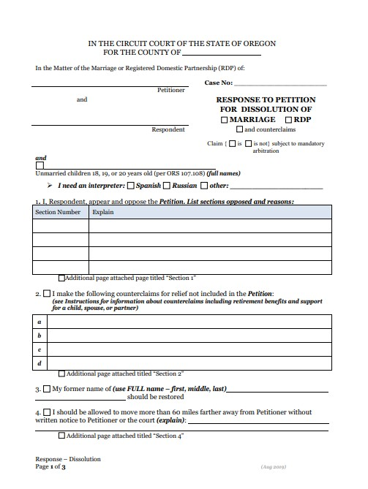
What if no Response is filed?
If the Respondent does not file a Response, the Petitioner can file paperwork requesting a “default.”
The court will then review all the paperwork to make sure Respondent was properly served with the court paperwork and the proper default paperwork was filed.
If there are no issues, the court will sign a “default judgment.” The default judgment must contain the same terms that the Petition included. It cannot include new terms or more specific terms.

Slide 28
What if a Response is filed?
The case becomes a “contested” case.
The Petitioner should review the Response carefully to understand what issues are in disagreement.
In order to finalize the case, the parties will need to either reach an agreement on all these issues, or they can take their case to trial and have a judge decide their disagreements.

Slide 29
MANDATORY ITEMS TO COMPLETE BEFORE TRIAL

Slide 30
MANDATORY ITEMS THAT MUST BE COMPLETED IN CASES INVOLVING CHILDREN
Parenting class (small fee, that can be waived)
Custody & parenting time mediation through Crook County (free)

Slide 31
Parenting class
Intended to educate parents about the effects of separation on children and provide parents with tips on co-parenting.
In Crook County, the class is called “Bridging the Gap.” You can register with BestCare Treatment Services at 541-323-5330.
Classes are 3-hours long and offered virtually.
Parents must file Certificate of Completion with the court.

Slide 32
Custody and parenting time mediation
Crook County offers free mediation for parents going through a divorce or custody case.
After a Response is filed, both parents are required to contact the mediator and complete the mediation orientation.
The purpose of mediation is to try to help parents reach an agreement on custody and parenting time outside of court. Parents should notify the mediator of their concerns, wishes, etc., and the mediator will try to help parents come up with a mutually agreeable parenting plan.
Parents are not required to reach an agreement in mediation.

Slide 33
OPTIONAL ITEMS TO COMPLETE BEFORE TRIAL

Slide 34
OPTIONAL ITEMS TO COMPLETE BEFORE TRIAL
Mediation (for all issues in case)
Settlement communications / negotiations
Requesting documents from other party (discovery)
Obtain temporary court orders

Slide 35
Mediation
If parties would like to try to resolve all the issues in their case without going to trial, they can hire a private mediator to help them reach an agreement.
Look for mediators who are attorneys or former judges.
Be wary of non-attorney mediators. There is no statewide certification or licensing requirements for someone to call themselves a “mediator.” Non-attorney mediators may not know the law, so the agreements they help you reach may not be legally enforceable. They also cannot help you draft the necessary legal documents to ensure your agreements become legally enforceable.

Slide 36
Settlement communications / negotiations
Parties may also wish to talk to each other to try to settle the issues in the case.
If parties have attorneys, their attorneys can negotiate on their behalf & send formal settlement offers.
There is no requirement to engage in settlement or negotiation communications.
Statements made during settlement communications or negotiations cannot be used against you in court.

Slide 37
Requesting documents from the other party (discovery process)
Parties may need to request documents from the other party if they do not know the extent of or do not have access to the other party’s assets, debts, or financial situation.
If a party serves a request for documents, the other party must respond.
There may be reasons to object to some requests for production.
Parties should consult with an attorney if they need to obtain important documents from the other side and the other party is refusing to produce them.

Slide 38
Temporary court orders
While a divorce or custody case is pending, either party can request temporary court orders. These orders remain in place until the case is finished and a final judgment is entered:
Orders regarding temporary custody and parenting time of children
Orders regarding temporary spousal support or child support
Orders regarding real or person property

Slide 39
COURT HEARINGS IN YOUR CASE

Slide 40
COURT HEARINGS IN YOUR CASE
Pre-trial conference
Trial readiness
Other hearings to address motions, temporary orders, discovery issues, etc.
Trial

Slide 41
What happens if there are no upcoming court hearings?
If you are ready for trial and have completed the mandatory requirements for parents, contact the court to request a trial date.

Slide 42
What if you need to reschedule a court hearing?
You should write a letter to the court as soon as possible requesting to reschedule your hearing or, if you are represented by an attorney, notify your attorney and have them request to reschedule the hearing on your behalf.

Slide 43
Court hearings during the pandemic
Most hearings are by phone / video
Court notice will indicate how to call in for the hearing
Evidence must be filed and served on the other party days prior to trial

Slide 44
Divorce & custody trials

Slide 45
TWO TYPES OF TRIALS
Informal Domestic Relations Trial (IDRT)
Form (traditional) trial

Slide 46
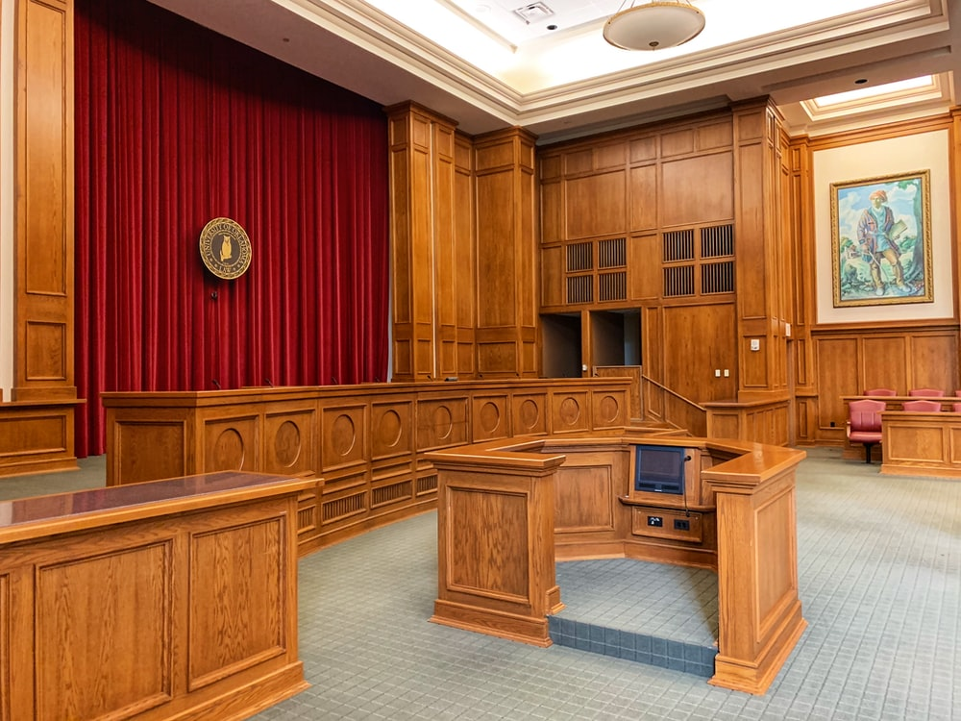
FORMAL (TRADITIONAL) TRIALS
More like trials you see on TV.
Parties must follow the rules of evidence.
Lawyers or parties can object to witness testimony or evidence.
People who have an attorney often have an advantage in a formal trial.

Slide 47
INFORMAL DOMESTIC RELATIONS TRIALS (IDRTs)
Intended for people without attorneys or for people who want to save money on attorney fees associated with trial
Both parties must consent to an IDRT
Rules of evidence do not apply
Attorneys have a limited role in IDRTs

Slide 48
TRIAL FORMAT (for formal trials)
OPENING ARGUMENTS
Each party gets an opportunity to summarize the issues in the case and the evidence that will be presented at trial.
The parties take turns presenting their cases. The Petitioner goes first, then the Respondent, the Petitioner can put on a rebuttal case.
CLOSING ARGUMENTS
Each party can make arguments about why the judge should rule in their favor based on the law and the evidence presented at trial.
EVIDENTIARY PORTION
JUDGE’S RULING
The Judge will make a decision on all the contested issues in the case.

Slide 49
Evidentiary portion of a trial
PETITIONER’S CASE
The Petitioner gets to put on their case first. They can testify, call witnesses, and present other to support their positions. The Respondent has an opportunity to cross-examine all witnesses.
The Respondent then gets to put on their case. They can testify, call witnesses, and present other evidence to support their positions. The Petitioner can cross-examine all of Respondent’s witnesses.
PETITIONER’S REBUTTAL CASE (OPTIONAL)
If the Petitioner wants to address any evidence presented by the Respondent, they can testify again or recall witnesses. The Respondent can cross-examine any witnesses that are recalled.
RESPONDENT’S CASE

Slide 50
WHAT EVIDENCE SHOULD YOU PRESENT AT TRIAL?
This will depend on the issues in your case…

Slide 51
Custody
ORS 107.137 requires the judge to make a custody decision in the best interests of the children. In making this decision, the judge must consider:
The emotional ties between the child and other family members;
The interest of the parties in and attitude toward the child;
The desirability of continuing an existing relationship;
The abuse of one parent by the other;
The preference for the primary caregiver of the child, if the caregiver is deemed fit by the court; and
The willingness and ability of each parent to facilitate and encourage a close and continuing relationship between the other parent and the child.

Slide 52
If custody is at issue, the judge will want to hear testimony and see evidence related to…
Who was the primary parent?
What is each parent’s relationship with the children like?
What is the children’s relationship with each parent?
Was there domestic violence?
Was there child abuse?
Does the other parent have drug or alcohol issues?
Are there other concerns with the other parent?
What type of relationship / contact do the children have with their extended family members?
Has either parent tried to alienate the children from the other parent?

Slide 53
Parenting time
Parenting time is decided according to the best interests of the children as well. In making a parenting time decision, the judge has significant discretion.

Slide 54
If parenting time is at issue, the judge will want to hear testimony and see evidence related to…
What are the parents’ schedules?
What are the children’s schedules?
Where do the parents work?
How close do the parents live to each other?
Where do the children go to school?
Are there safety concerns for the children?
Do the children have extracurricular activities that need to be accommodated?
Do the children have special health concerns?

Slide 55
Child support
Child support is calculated by applying the child support guideline rules and using the online child support calculator. https://justice.oregon.gov/guidelines/

Slide 56
If child support is at issue the judge will want to hear testimony and see evidence related to…
How much does each parent earn from employment?
Does either parent have other income (gifts from family, stock earnings, bonuses, etc.)
Does either parent have a disability preventing them from working?
What are the health insurance costs for the parents and children?
Which parent provides health insurance?
Does either parent receive spousal support from someone?
Does either parent pay child care costs?
Does either parent receive social security benefits for a child?

Slide 57
Division of property
Property includes real estate, financial accounts, as well as personal property like household goods, vehicles, etc.
In a divorce case, a judge should divide any property that was acquired by either party during the marriage 50/50, unless they make a determination that some other division is “just and proper.”
Pre-marital property can be divided by the judge as well if the judge finds it “just and proper.”

Slide 58
If the division of property is at issue the judge will want to hear testimony and see evidence related to…
What property do the parties own?
When was the property acquired?
What is the property worth?
Is the property encumbered with loans or mortgages?
Who should be awarded the property?
Should either party be awarded an equalizing judgment to compensate for an unequal distribution of property?
Why is this division fair?

Slide 59
Division of debts
Debts include credit card debts, auto loans, mortgages, student loans, etc.
In a divorce case, a judge should divide any debts acquired by either party during the marriage 50/50, unless the judge makes a determination that some other division is equitable.

Slide 60
If the division of debts is at issue the judge will want to hear testimony and see evidence related to…
What debts did the parties have at the time of separation?
What was the amount of debt at the time of separation? (or currently if that makes more sense)
Whose name is associated with the debt (is it a joint debt or only in one party’s name)?
How should the debts be divided?
Why is it fair to divide the debts that way?

Slide 61
Spousal support
There are no hard rules for when a judge must award spousal support. This is a discretionary decision. Instead, the judge considers the type of support sought and then weighs the statutory factors in ORS 107.105(1)(d).
There are three types of spousal support:
Maintenance
Transitional
Compensatory

Slide 62
If spousal support is at issue the judge will want to hear testimony and see evidence related to…
Each parties’ incomes and total earnings
The age of the parties
The educational backgrounds of each party
Each party’s work experience and earning history
Whether either party has a disability that prevents them from working
Whether either party supported the other party financially during the marriage
Whether either party supported the other party while that party obtained education / training

Slide 63
What a judge does not want to hear about in a divorce case without children
Oregon is a no-fault divorce state. This means that if you do not have children, the judge cannot consider the following when deciding the issues in your case:
Cheating
Domestic violence
Drug or alcohol use
Criminal history
Other bad acts committed by either party unless they are directly related to the division of debts and / or assets

Slide 64
HOW DOES A JUDGE MAKE THEIR RULING?
The judge will hear all the evidence presented at trial and make “findings of fact.”
The judge will then decide how the law applies to these facts.

Slide 65
WHEN WILL YOU FIND OUT THE JUDGE’S DECISION?
Some judges will issue their decision at the end of your trial.
Some judges may take your case “under advisement” and then issue a written opinion, which is mailed to the parties. If this happens, the judge should issue their opinion within 60 days of trial.

Slide 66
WHEN IS YOUR CASE FINALIZED?
Your case is finally over when a judge signs your judgment and the judgment is entered in your court file.
If either party has an attorney, the attorney will usually be asked to prepare the judgment.
If there are no attorneys involved, the court may prepare the judgment for the parties.

Slide 67
MODIFICATION OF JUDGMENTS
Certain portions of a judgment can be modified:
Custody -- can be modified if there has been a “substantial change of circumstances”
Parenting time – can be modified if a change is in children’s best interests
Child support & spousal support – can be modified if there has been a “substantial change of circumstances”
Division of property & debts – cannot be modified (unless a party discovers new evidence later related to previously unknown assets or debts)

Slide 68
QUESTIONS?
Legal Aid Services of Oregon
42 NW Greeley aVE, Bend, OR 97701
541-385-6944

