Slide 1
Bowman Museum

Slide 2
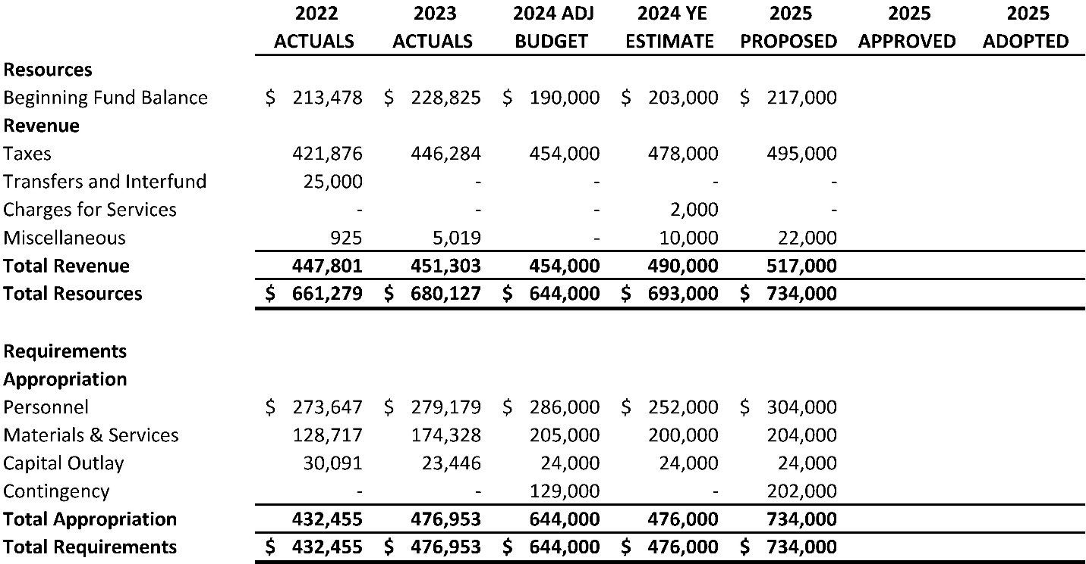
Bowman Museum Fund
Proposed Budget – FY 2025

Slide 3
Bowman Museum: Challenges
Proposed Budget – FY 2025
Address operational deficit through grants and donations
Explore new revenue sources through donations, grants, and fundraising
Provide more services and events with limited staffing

Slide 4
Bowman Museum: Highlights
Proposed Budget – FY 2025
Redesign Bookstore
Complete Phase I of Rancher Memorial renovation
Renovation of 1st floor museum exhibit
Expand outreach and community engagement to include more programs and school events through community partnerships

