Slide 1

Sheriff’s Office
Mission
“We work in partnership with our citizens to preserve life, protect property, hold offenders accountable, and conserve the peace.”
Major goals
Hiring/staffing
Peer support
Radio upgrade
Notes:
Enter your department in Header area
Enter the department’s mission statement
Enter the department’s major goals/work plan elements
Add the department logo to bottom left corner, same size as County logo

Slide 2
Sheriff’s Office
Financial Summary amounts in thousands
 | Budget | Actual | Variance
Beginning balance | $1,909 | $1,904 | $(5)
Revenue | $8,273 | $8,107 | $(166)
Expenses - Sheriff’s Office | $1,532 | $1,465 | $67
Expenses - Jail | $1,438 | $1,182 | $256
Expenses - EMPG | $115 | $85 | $30
Expenses – Parol & Probation | $543 | $498 | $45
Ending balance | $6,554 | $6,782 | $228
Comments
Notes:
Enter department in header
Enter the department’s quarterly budget, actual and variance amounts ---- in thousands
Enter comments to explain any significant variances
Add the department’s logo to the bottom left corner, same size as County logo

Slide 3
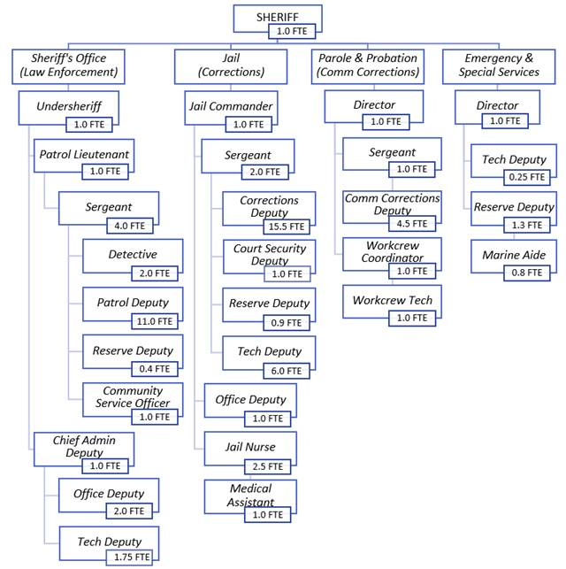
Sheriff’s Office
Staffing Summary
Comments:
Revenue shortage due to dollars hitting later the quarters and will catch up.
The staffing summary below has been updated to finance position count (current), rounded to whole full-time numbers, not including part-time/seasonal staffing.
Org Chart
Staffing Summary
Authorized | Filled | Vacancies
73 | 61 | 12
Notes:
Enter department in the bottom header
Enter the department’s organization chart
Provide some bullets describing personnel during the quarter, e.g., number of new employees, separations, etc.any pending recruitments, significant new hires or seprarations
Enter the department’s authorized, filled and vacate positions – FTEs as of end of the quarter
Add the department logo to the left of the County logo – same size as County logo

Slide 4
Sheriff’s Office
Q1 FY 2024
Goal/work plan description | Activity during quarter | Comments
Patrol: Radio efficiency Hiring for Patrol Vehicles | Working with IT to build/upgrade radio towers – Still in process Ran process which concluded w/3 offers and one started Dec. 23, 1 washed out and 1 started in January. Concluded paying for equipment as well as 4/14 upfit/completed and on the road
Emergency Management: Fund and complete NHMP/CWPP Purchase and fund EOC generator Get backup 911 center operational | Working with finance and partners to begin project - Still in process Secured grant for funding – Still in process Met with IT to discuss funding and equipment needs – Still in process
Notes:
Replace “Department” with your department name in header
List the major goals/work plan elements for the department
Provide a brief description of activity on each goal/work plan item
List any challenges or changes or other comments for each goal/work plan item
Add additional lines as needed – go to next page if needed
If additional page added, delete “Questions”
Add department logo to left of the County logo – same size as County logo

Slide 5
Sheriff’s Office - continued
Q1 FY 2024
Goal/work plan description | Activity during quarter | Comments
Jail: Jail Nurse Salary review | Identified that there is a gap and retention could become a real issue – continues Q2.
Hiring/staffing Long term goal/turn corporal into Sergeant positions for leadership Parole and Probation: Long term goal/mental health division | Completed hiring process, ending with extending/hiring 1 new Correction Deputies. Identified that with larger teams we will need more adequate supervision of each team – working for budget 25 Gathering data with the one dedicated mental health position currently working – continues Q2
Notes:
Replace “Department” with your department name in header
Continue your list of the major goals/work plan elements
Provide a brief description of activity on each goal/work plan item
List any challenges or changes or other comments for each goal/work plan item
Add additional lines as needed – go to next page if needed
If additional page added, delete “Questions”
Add your department logo to left of the County logo – same size as County logo

Slide 6
Sheriff’s Office - continued
Q1 FY 2024
Goal/work plan description | Activity during quarter | Comments
Sheriff’s Office as a whole: Peer support and Wellness programs | Received LEMWHA federal grant, began process of selecting members for the peer support group – Q2 began process for selection of peer members and scheduling peer support training.
FY25 Budgetary Impact Requests Sheriff's Office CSO position - Jail Corporal positions x2 | Requesting to convert CSO to certified deputy position. Requesting to convert jail corporal positions to Sergeant positions.
Notes:
Replace “Department” with your department name in header
Continue your list of the major goals/work plan elements
Provide a brief description of activity on each goal/work plan item
List any challenges or changes or other comments for each goal/work plan item
Add additional lines as needed – go to next page if needed
If additional page added, delete “Questions”
Add your department logo to left of the County logo – same size as County logo

Slide 7
Sheriff’s Office Performance Measures
Q1 FY 2024
Performance measure | Goal | Actual | Comments
Improve employee retention/reduce turnover Timely response to calls Manageable caseloads 4. Maintain affordable cost per day per inmate | Fully staff divisions Priority calls to less than 20 min Reduced calls per deputy No increase in cost | 4 vacancies in Jail and 4 total in Patrol Varies depends on call activity CFS are up about 18.37% Same rate at $120/day | Continuing to hire staff and train them as fast as possible Due to the size of response area, it is impossible to set specific times. Current caseload per deputy increased 11.91% Q2 bookings are at 353 which is a 23% increase over Q2 FY23
Questions
Notes:
Replace “Department” with your department name in header
Enter performance measures, goal and actual, with comments --- use performance measures included in the budget as a starting point, additional measures are encouraged
Add your department logo to left of the County logo – same size as County logo

