Slide 1


District Attorney
Mission
It is the mission of the Crook County District Attorney’s Office to seek justice, promote community safety, and uphold the law. We will vigorously and impartially pursue this mission with fairness, integrity and honor and in a manner to promote public trust in the criminal justice system and serve our community.
Major goals
Continue participation and support of Recovery Court, Wellness Court and Truancy Court to provide increased treatment opportunities for repeat offenders. Our goal is to reduce or eliminate future unlawful activity.
Enforce child support orders and assist in job searches for parents needing assistance.
Implement procedures to address ongoing staffing shortages and growing caseloads
Notes:
Enter your department in Header area
Enter the department’s mission statement
Enter the department’s major goals/work plan elements
Add the department logo to bottom left corner, same size as County logo

Slide 2
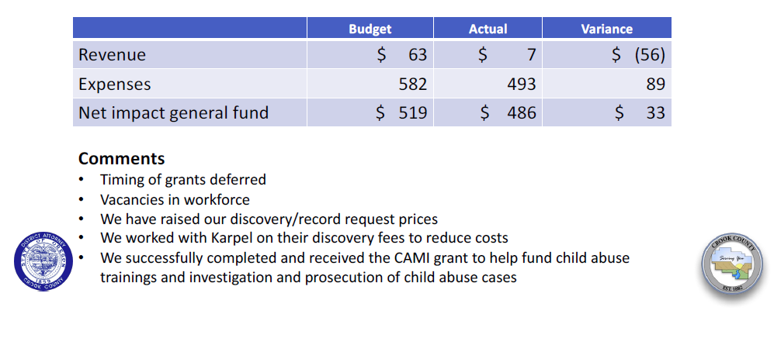
District Attorney department
Financial Summary amounts in thousands
 | Budget | Actual | Variance
Revenue | $ 76 | $ 56 | $ (20)
Expenses | 628 | 548 | 80
General fund net impact | $ (552) | $ (492) | $ 60
Notes:
Enter department in header
Enter the department’s quarterly budget, actual and variance amounts ---- in thousands
Enter comments to explain any significant variances
Add the department’s logo to the bottom left corner, same size as County logo

Slide 3
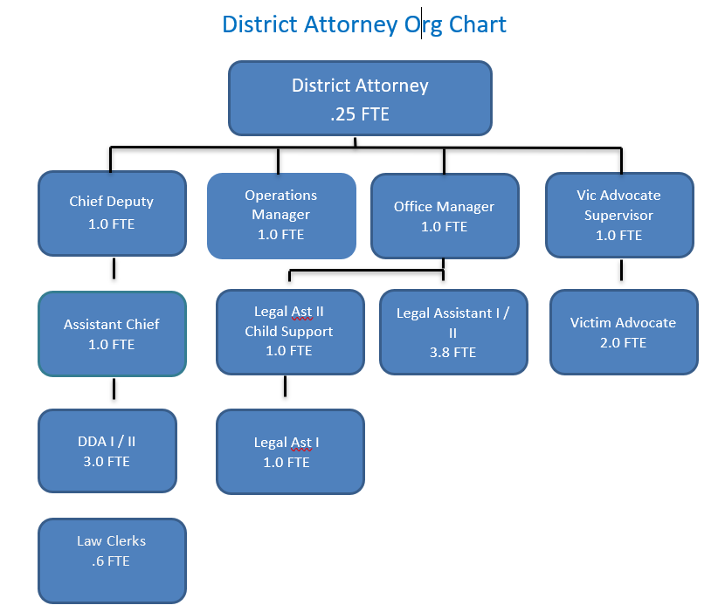
District Attorney
Staffing Summary
Comments:
The District Attorney’s office hired an assistant chief deputy to help with major sex abuse cases and mentoring DDAs
Created an operations manager position to oversee the overall workflow of the office
Implemented fast track program to address growing caseload, staff shortage, and promote early accountability
Staffing Summary*
Authorized | Filled | Vacancies
16.25 | 14.25 | 2
*Does not include law clerk .6 FTE
Notes:
Enter department in the bottom header
Enter the department’s organization chart
Provide some bullets describing personnel during the quarter, e.g., number of new employees, separations, etc.any pending recruitments, significant new hires or seprarations
Enter the department’s authorized, filled and vacate positions – FTEs as of end of the quarter
Add the department logo to the left of the County logo – same size as County logo

Slide 4
District Attorney Activities
Q1 FY 2024
Goal/work plan description | Activity during quarter | Comments
Increase consistency and implement procedures to address increased caseloads and ongoing staffing shortages | Draft revised charging and plea offer procedures and policies | This is ongoing and we continue to work with community partners and the Court
Drafting a new employee binders with policies and resources to help with training | The binder will have step by step instructions for a new employee to find the answers they need when a manager is not available | I am hoping to have this ready to go by Q2. With frequent turnover, we need to streamline training
Implement Trial Checklist for use in preparing for trial | This has been implemented and is currently being used | This will help our legal assistants and our DDAs effectively prepare for trial and improve communication
Notes:
Replace “Department” with your department name in header
List the major goals/work plan elements for the department
Provide a brief description of activity on each goal/work plan item
List any challenges or changes or other comments for each goal/work plan item
Add additional lines as needed – go to next page if needed
If additional page added, delete “Questions”
Add department logo to left of the County logo – same size as County logo

Slide 5
Department Activities - continued
Q1 FY 2024
Performance measure | Goal | Actual | Comments
Attorney caseload assignments should be reduced to a manageable volume Recruit & Retain Employees | Felony attorney: 40-60 Misdemeanor: < 100 Fill vacant openings and reduce turnover | DDAs =150-200 DA = 100 Vacancies: 1 DDA 1 Legal Ast 2 Law clerk | I’ve revised the intake process workflow to alleviate the significant attorney caseload and implemented a fast track plea offer program to promote early accountability and resolution Focus on recruiting law clerks Retention-we continue to implement retention practices, including internal career advancement
Questions
Notes:
Replace “Department” with your department name in header
Continue your list of the major goals/work plan elements
Provide a brief description of activity on each goal/work plan item
List any challenges or changes or other comments for each goal/work plan item
Add additional lines as needed – go to next page if needed
If additional page added, delete “Questions”
Add your department logo to left of the County logo – same size as County logo

